Slide 1
The knapsack problem (3D)
Group 8
Adam Eljasiak
Daniel Kaestner
Simon Wengeler
Raffaele Piccini
Nicola Gheza
Henri Viigimäe

Slide 2
Contents (quick introduction)
1. Assignment description
2. Assignment results
3. Implemented algorithms
4. Experiments and results
5. Conclusions

Slide 3
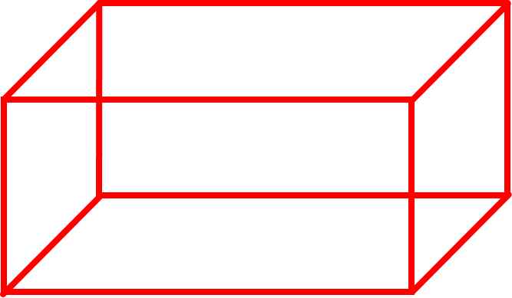
Assignment description
Application for solving three-dimensional knapsack problems
Three packages with certain values and a cargosace
A: 1.0 x 1.0 x 2.0 (m) with a value of 3
B: 1.0 x 1.5 x 2.0 (m) with a value of 4
C: 1.5 x 1.5 x 1.5 (m) with a value of 5
Cargospace: 16.5 x 2.5 x 4.0 (m)
16.5 (m)
4 (m)
2.5 (m)

Slide 4
ASSIGNMENT RESULTS

Slide 5
Using rectangular packages
No solution to filling the entire cargo space with A,B and/or C packages has been found.
Best result found for maximizing a single packing: 240

Slide 6
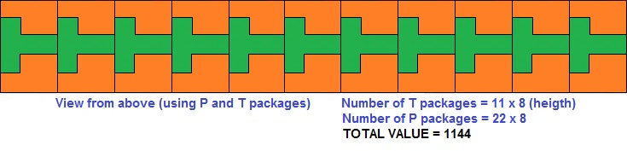
Using pentomino-shaped packages
It is possible to fill the entire cargospace with L,P and/or T packages.
Best result found for maximizing a single packing: 1144

Slide 7
GREEDY ALGORITHM

Slide 8
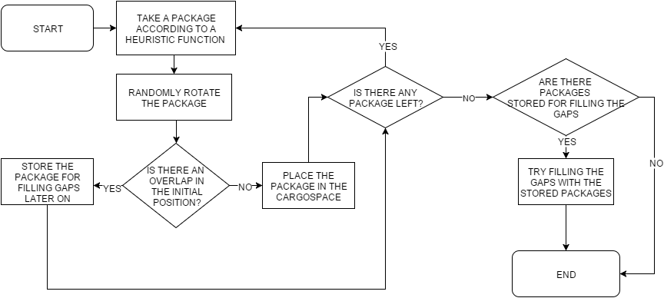
Implementation

Slide 9
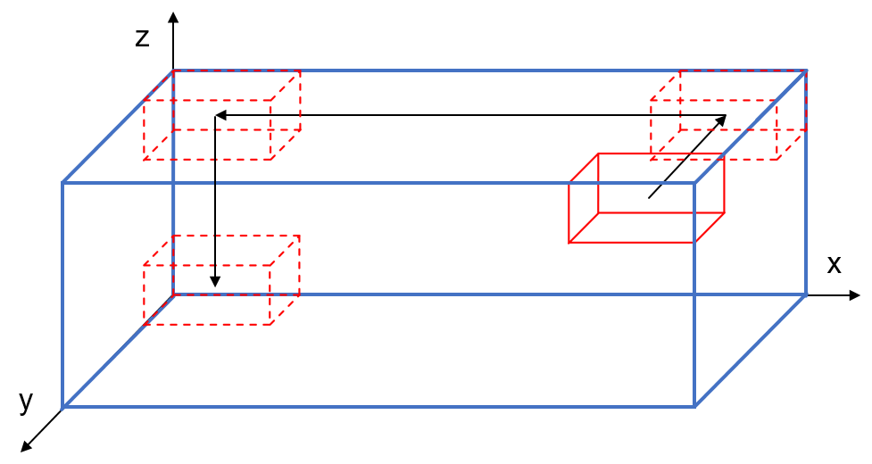
The placement method
Initial position
Is there an overlap at the initial position?
Move package as far to the back (y-axis), then as far to left (x-axis) and as far down (z-axis) as possible

Slide 10
HILL CLIMBING ALGORITHM

Slide 11
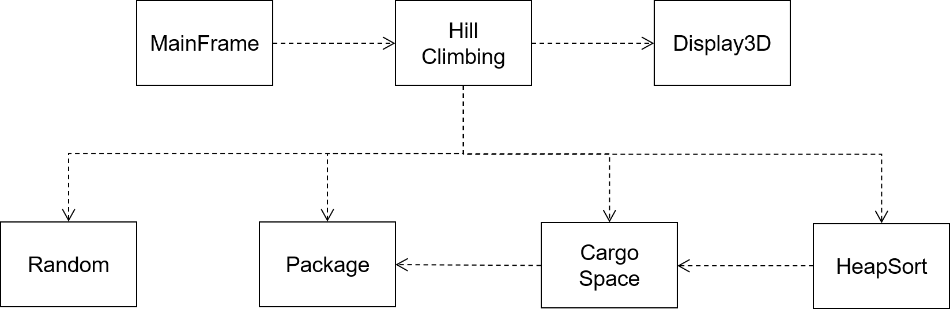
Implementation
Start with an arbitrary solution
Create neighbouring solutions (change n random packages and fill the remaining empty space)
Choose the best next solution based on an objective function (maximizing the value of a packing)
Repeat until no further improvements can be made

Slide 12
GENETIC ALGORITHM

Slide 13
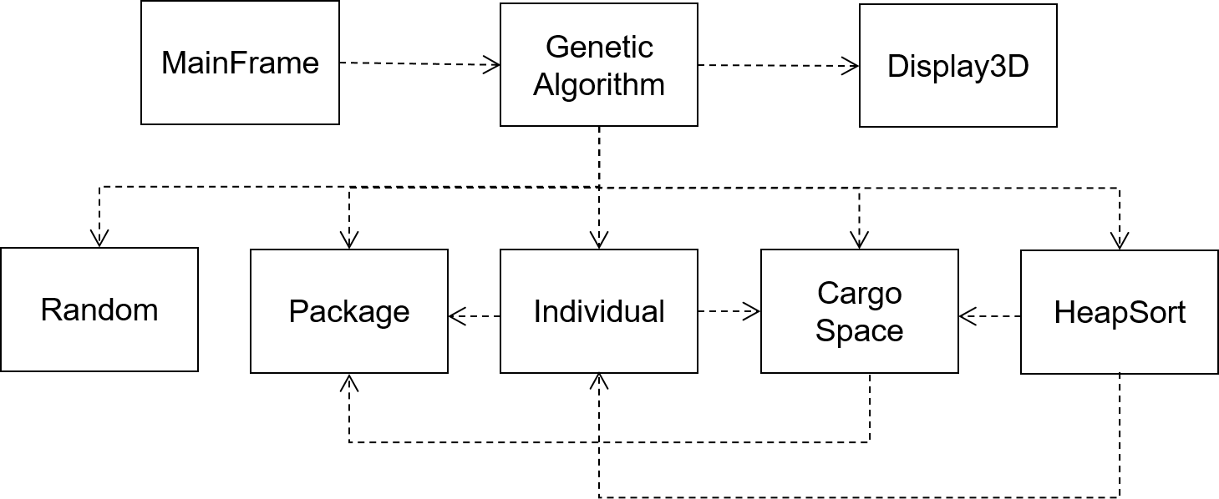
Implementation
Chromosomes (an array consisting of 0’s and 1’s) of each individual are generated randomly for the initial population.
These “genes” decide if a certain package in a certain state is included in the solution.
The binary string is converted into a packing to evaluate the fitness of an individual

Slide 14
EXPERIMENTS AND RESULTS

Slide 15
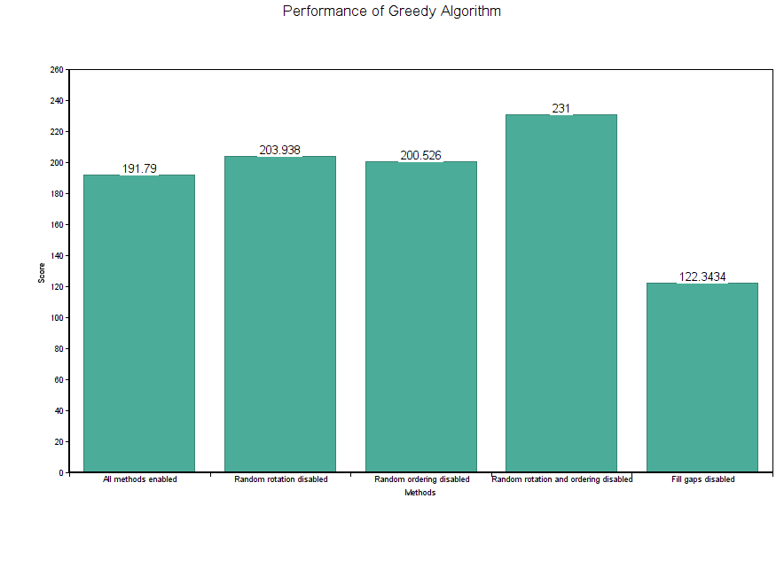
EXPERIMENTS AND RESULTS (GREEDY ALGORITHM)
Finding the best total value
30 packages
1000 runs

Slide 16
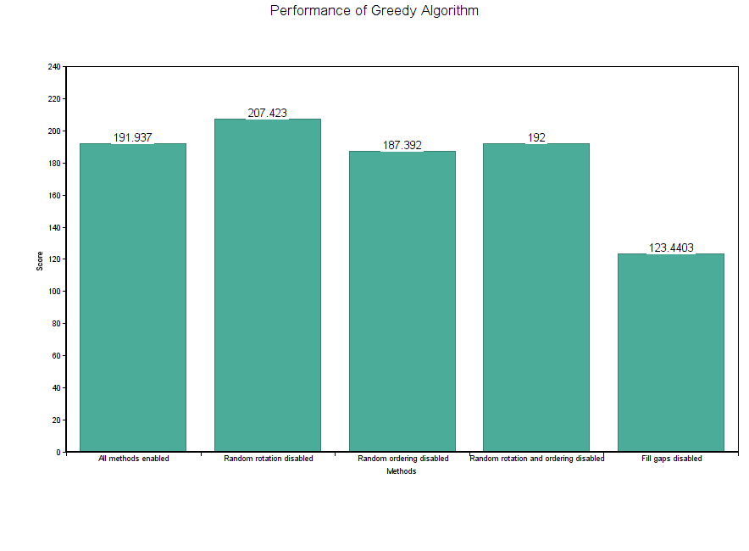
Finding the best total value
100 packages
1000 runs

Slide 17
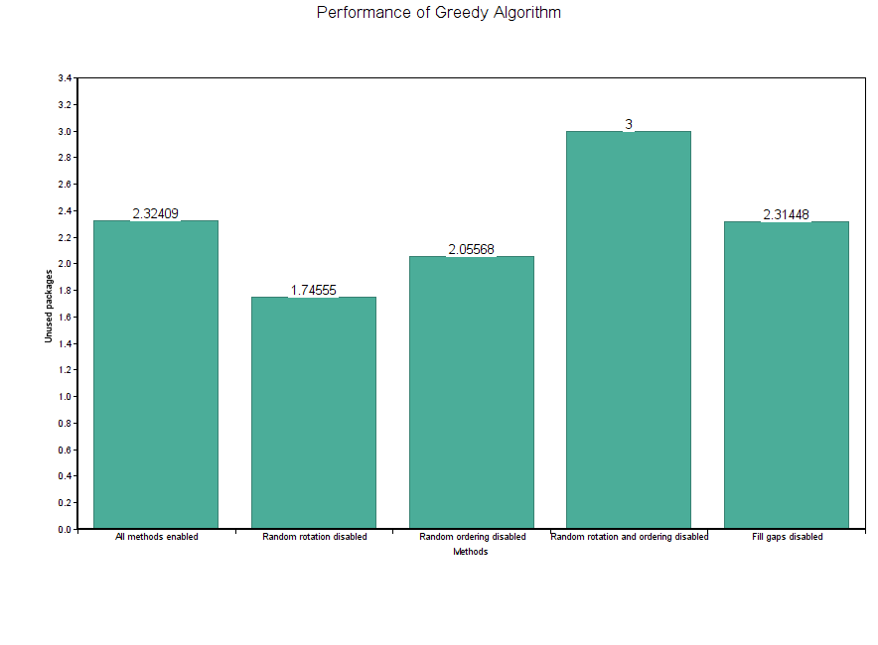
Packages that remain unused
10 packages
100000 runs

Slide 18
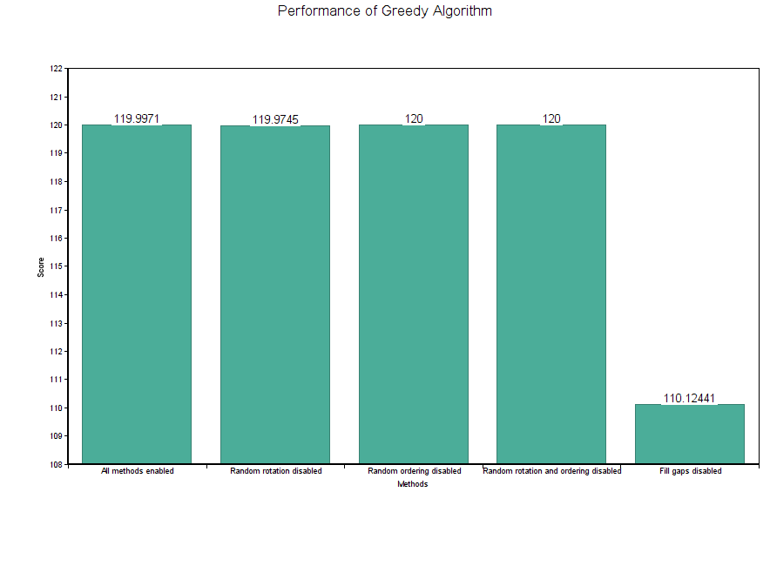
Finding the best total value
10 packages
100000 runs

Slide 19
EXPERIMENTS AND RESULTS (HILL CLIMBING)

Slide 20
EXPERIMENTS AND RESULTS (GENETIC ALGORITHM)

Slide 21
Population size
Increase in population size yields better results
Affects the tournament selection method the most
Large increase in the average result achieved
Significant decrease in runtime

Slide 23
Mutation probability
Increasing the mutation probability decreases the performance of the algorithm (both value and runtime wise)
This could be due to the way best solution is achieved (no rotations)

Slide 24
External factors
Experiments with different number of packages and new package types
No correlation between performance and certain package shapes
Genetic algorithm has the best performance

Slide 25
Conclusions
Greedy algorithm is the fastest but does not perform as well as other algorithms.
Hill climbing algorithm achieves good results but might get stuck.
Genetic algorithm is time consuming and has a lot of parameters that need to be taken into account (difficult to implement) but it gets closest to the optimal solution.
CONCLUSIONS:
For the quickest solution: Greedy algorithm
For reasonably fast and good solutions: Hill Climbing algorithm
For the optimal solution: Genetic Algorithm

